Slide 1


Department of ICT
A project-I mid-term defense on:
“All In-1”
Project Members:
Aachal Sah 210301
Jyoti Shah 210311
Kanchan Shrestha 210346
Samriddha Upreti 210327
Submitted to:
Department of ICT
Cosmos College of Management and Technology
Date : 18th Jan, 2024
Department of ICT, Cosmos College of Management and Technology

Slide 2


INTRODUCTION
E-commerce (electronic commerce or EC) is the buying and selling of goods and services, or the transmitting of funds or data, over an electronic network primarily the internet.
It is a modern methodology that addresses the needs of organizations, merchants and consumers to cut costs while improving the quality of goods and services and increasing the speed of services delivery.
Department of ICT, Cosmos College of Management and Technology

Slide 3
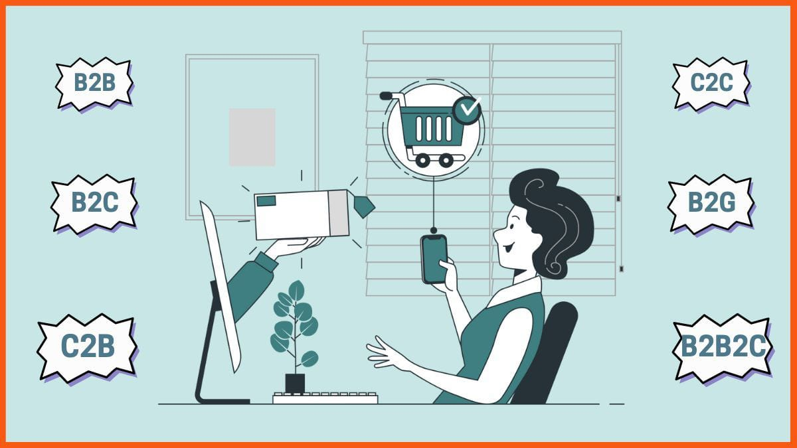
Types of E-commerce
Department of ICT, Cosmos College of Management and Technology

Slide 4
Business-to-consumer(B2C)
When business sells products or services directly to the individual consumer, it is considered B2c e-commerce.
It is the most common online business type and covers a broad array of products, from clothing to entertainment.
Examples of B2C e-commerce stores in Nepal includes:
Online shopping(daraz.com)
Food delivery services(Foodmandu)
Online transportation service(pathao, indriver, cab, etc)
Department of ICT, Cosmos College of Management and Technology

Slide 5
PROBLEM STATEMENT
User Interface (UI) Design
Database connection
Department of ICT, Cosmos College of Management and Technology

Slide 6
OBJECTIVES
General Objective:
To develop a functional and user-friendly e-commerce website that allows customers to browse, select and purchase products effortlessly.
Specific Objective:
To build a well-organized product catalog with clear categories and search functionalities to enable users to quickly find and explore items of interest.
To implement a straightforward and hassle-free checkout process, minimizing the number of steps required for users to complete their purchases.
Department of ICT, Cosmos College of Management and Technology

Slide 7
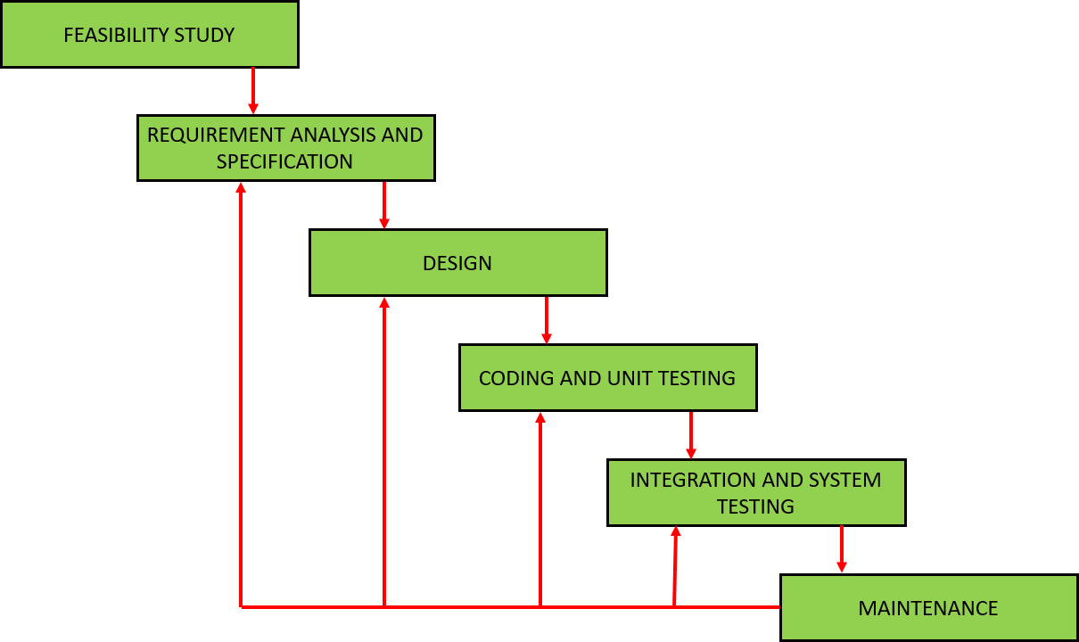
METHODOLOGY
Iterative Waterfall model
https://testbytesnxtjsbackend.technoallianceindia.com/wp-content/uploads/2019/05/water-1.jpg
Department of ICT, Cosmos College of Management and Technology

Slide 8
WORK PROGRESS
Accomplished Work:
Substantial progress has been made on the project, with the completion of the following tasks:
1. Design and Front-End Development
2. Database Design
3. System Design
Department of ICT, Cosmos College of Management and Technology

Slide 9
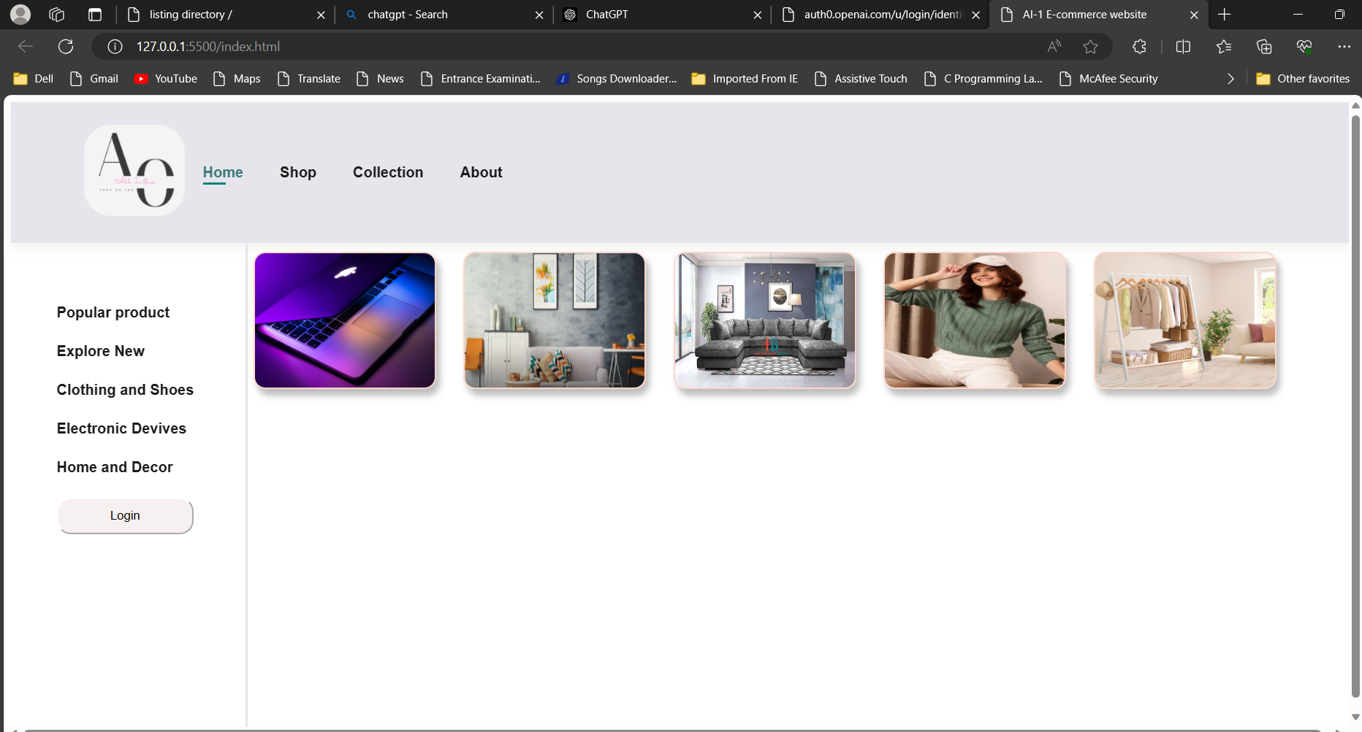
LANDING PAGE
Department of ICT, Cosmos College of Management and Technology

Slide 10
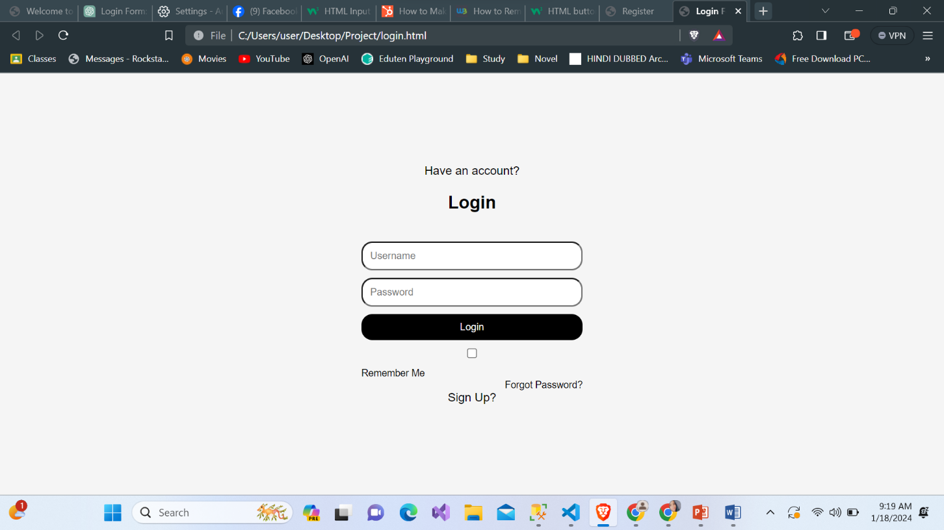
LOGIN PAGE
Department of ICT, Cosmos College of Management and Technology

Slide 11
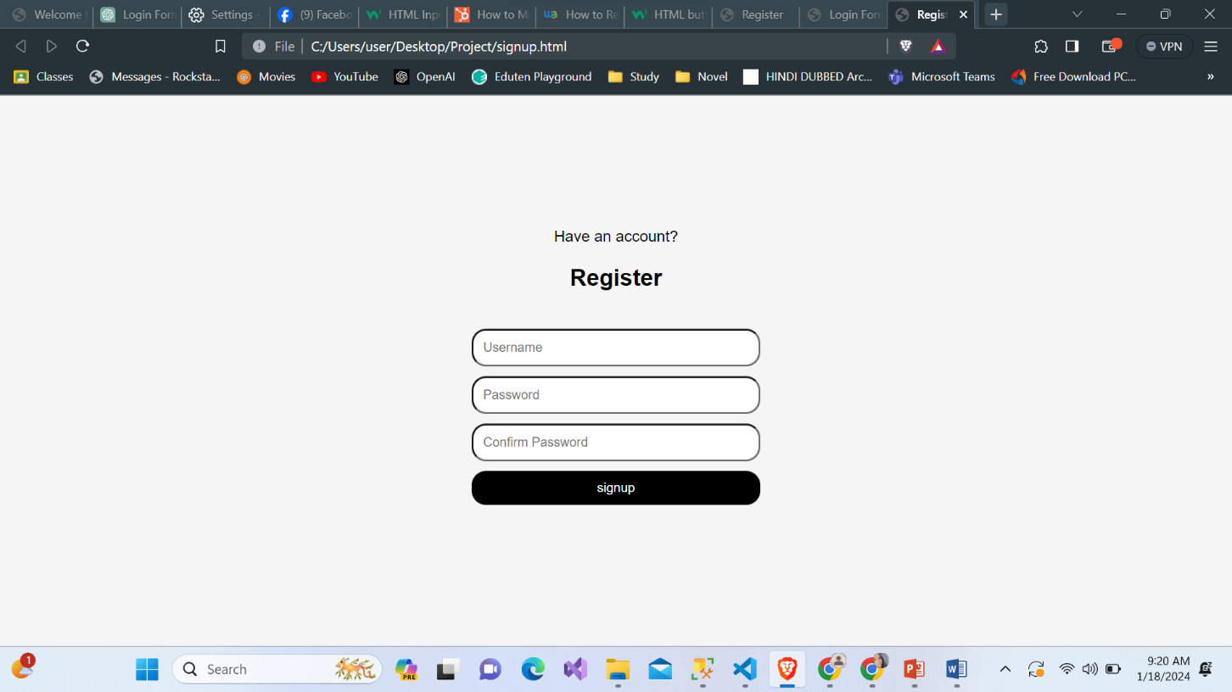
REGISTRATION PAGE
Department of ICT, Cosmos College of Management and Technology

Slide 12
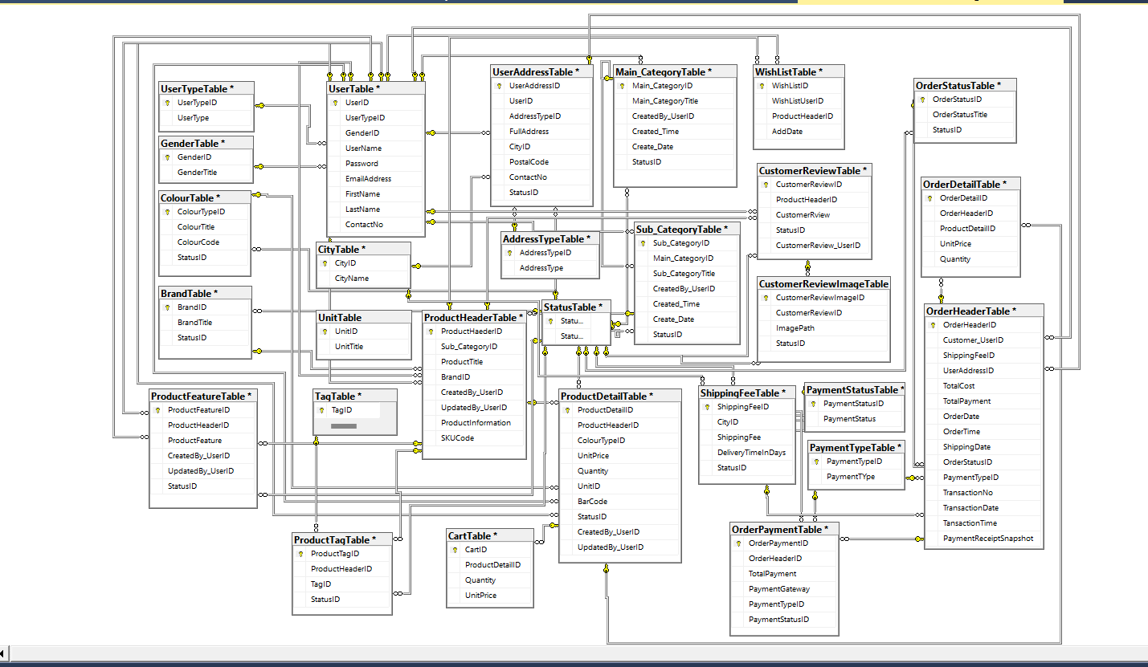
SCHEMA DIAGRAM
Department of ICT, Cosmos College of Management and Technology

Slide 13
REMAINING WORK
While significant progress has been made, there are several remaining tasks to complete for the project:
Back-End Development
Testing and Debugging
Documentation
Deployment
SQL Connection.
Department of ICT, Cosmos College of Management and Technology

Slide 14

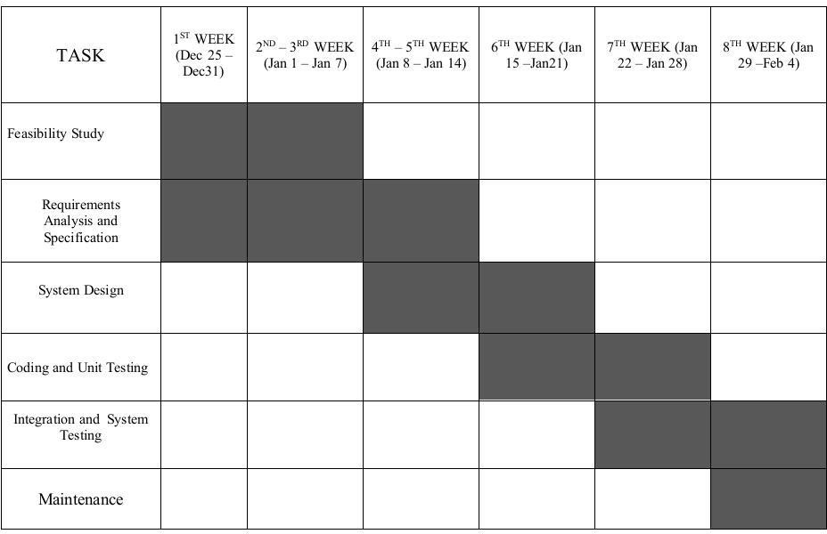
TIME SCHEDULE
Department of ICT, Cosmos College of Management and Technology

Slide 15
Thank You!
Department of ICT, Cosmos College of Management and Technology

